Slide 1
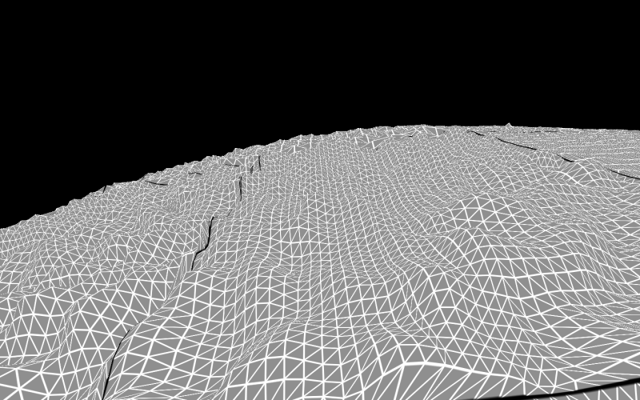
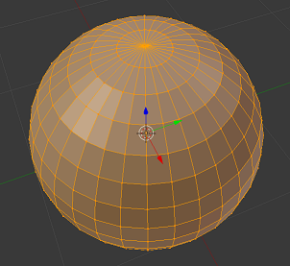
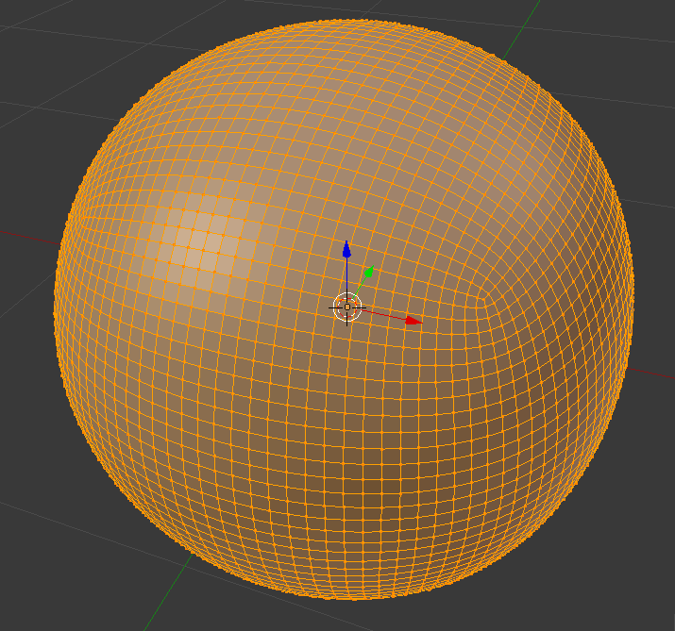
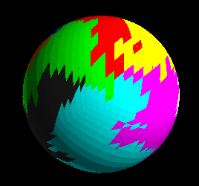
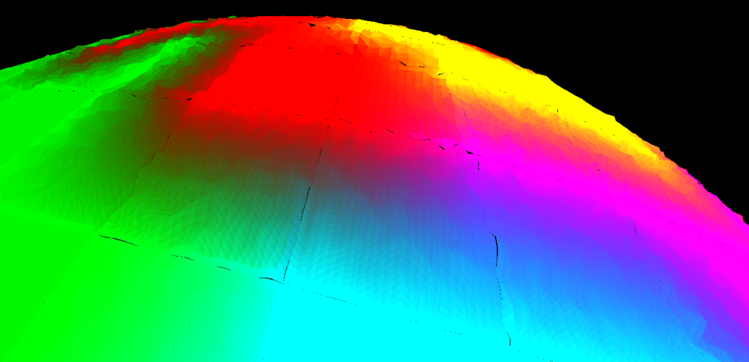
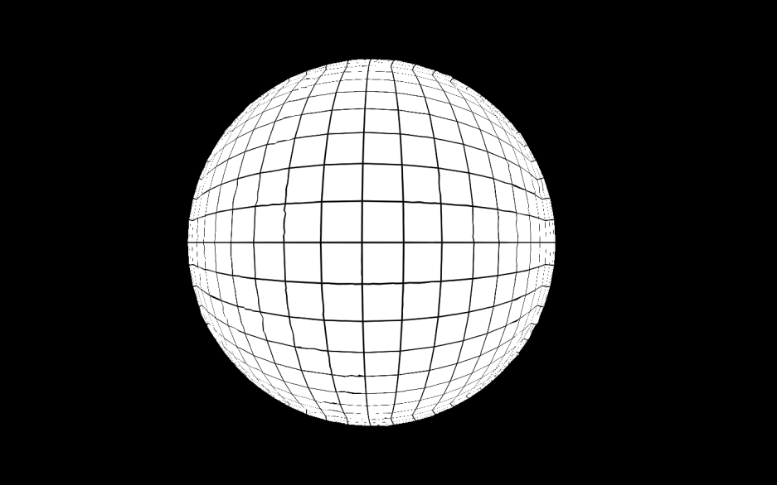
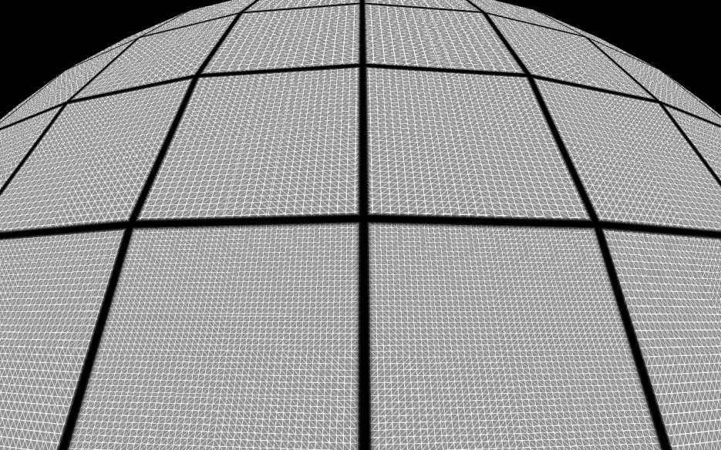
Building and Rendering Planetary Bodies With Plate Tectonics Justin Powell - 2015
Goals / Design Requirements:
Generation and rendering of solid planetary bodies such as planets and moons.
Terrain generation through plate tectonics.
Dynamic level of detail to increase performance.
Perlin Noise:
Plate tectonics alone is not enough to generate good looking terrain.
Perlin noise fills in the gap by procedurally generating a height-map for each vertex of the mesh.
Produces hiils, vallys, plains, etc. on an otherwise flat face.
Ties in with the tessellation and gets more detailed the higher the tessellation of the face is.
Drives the interactions between the plates.
Model Mesh Representation:
Quad sphere design eliminates the concentration of vertices at the poles as found in a UV-sphere based mesh.
Gives the mesh a more even distribution and size of vertices and faces.
Allows for easy tessellation to increase the level of detail.
Plate Tectonics:
Tectonic Plates are created during the base mesh generation.
Initial faces are selected.
A face from the plate that still has unassigned neighbors is selected and an adjacent face that is unassigned is randomly selected and added to the plate.
Repeat for the next plate.
Repeat until all faces have been assigned to a plate.
Each vertex is assigned a color based on the plate it belongs to.
These colors are used by the graphics card to modify the Perlin noise function generating the height-map for that vertex.
Along plate boundaries the Perlin noise function grows more rough and jagged, producing mountains.
Tessellation:
The mesh is initially tessellated to user preferences during the generation of the base mesh.
The mesh is then passed to the graphics card as patches.
Additional tessellation is performed by the graphics card on these patches in the tessellation shader portion of the rendering pipeline.
The level of tessellation is calculated based on the distance from the viewer.
As the camera gets closer to the patch, the level of tessellation increases, increasing the detail of the visible terrain.
Distant patches are tessellated at a lower level to increase performance.

